Slide 1
Forecasting weather and its different components using KNN & RNN
-A proposal of machine Learning project
Section - A
GROUP MEMBERS:
ZAFRIN SULTANA(19-39345-1)
RIMON NATH (18-38929-3)
PIU TERASA COSTA(18-38286-2)

Slide 2
TABLE OF CONTENT
Introduction
-Problem definition
-Project purpose
-Solution design
Methodology
- About dataset
-Diagram analysis
Results
Discussion & conclusion
References

Slide 3

Introduction
Weather has a profound effect on human health and well-being. The climate is changing at a drastic rate nowadays, which makes the old weather prediction methods less effective and more hectic due to different indicators factor.
As predictions affect a nation’s economy and the lives of people,an improved and reliable weather prediction method is required.

Slide 4
Problems Definition
1
Problems concern availability, timeliness, and quality of observational data
2
Time constraints on forecast preparation
3
The nature and reliability of communication systems available for forecast dissemination
4
The makeup and requirements of the user community.

Slide 5
Purpose
Forecasting long-term trend of weather and its different parameter that can be used in remote areas is much needed.
The prime objective of this work is to develop a low cost, reliable, and efficient weather forecasting application using the machine learning concept KNN and RNN in Python.
No need of complex memory module like GRU or LSTM.

Slide 6
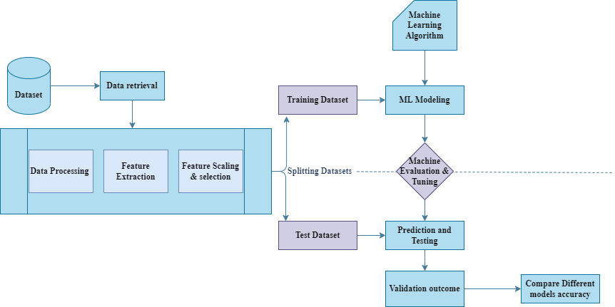
Methodology
The whole prediction of weather will be evaluated by using K-nearest neighbour (KNN) model. In addition, Recurrent Neural Network (RNN) model will be implemented to individual parameters of weather(humidity, temperature, air pressure, and so on) to forecast the long-term trend of the parameters.

Slide 7
Proposed dataset
The dataset consists of historical weather parameters (temperature, pressure, relative humidity) for major North American and other cities around the world over an extended time period of 2012 to 2017. Hourly data points are recorded, giving, over 45000 data points, in total.
By attempting to do a prediction, we are implicitly assuming that the past weather pattern is a good indicator of the future.
For this analysis, we focus only on the data for the city of Boston.
The full dataset can be found here: https://www.kaggle.com/selfishgene/historical-hourly-weather-data

Slide 8
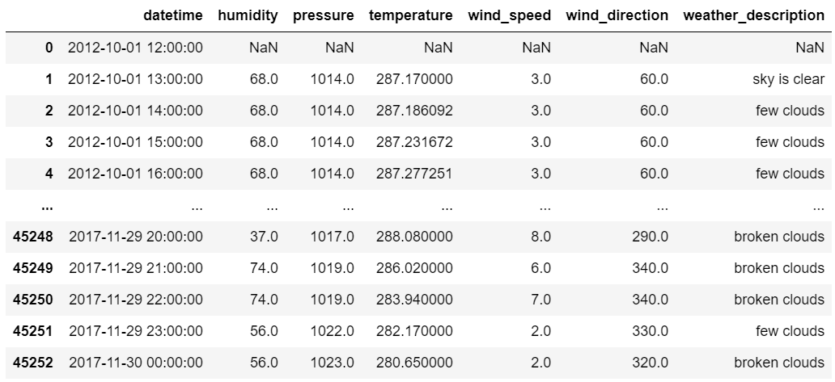
About dataset
The feature variables:
Date
Humidity
Pressure
Temperature
Wind direction
Wind speed
The targeted variable:
Wind description
Individual Parameters will also be predicted. In this project we’ll focus only for a particular city to predict the weather and other parameters.Further work can also be done by considering other indicators.

Slide 9
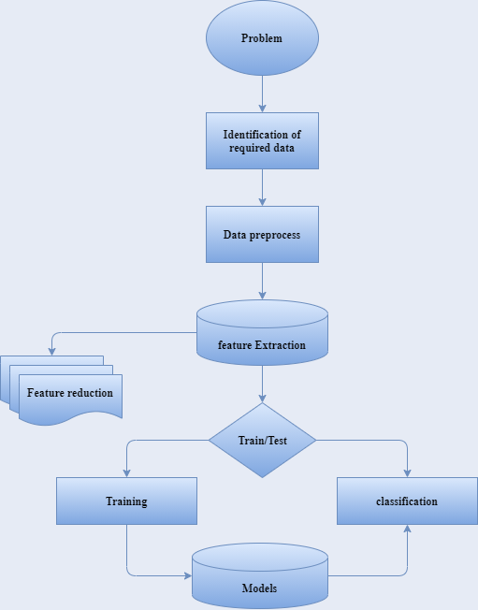
Diagram Analysis
For Visualization:
Matplotlib
Seaborn
Pandas
For smoting:
Inblearn
For Modeling:
Numpy
Keras
Tensorflow
Jupyter

Slide 10
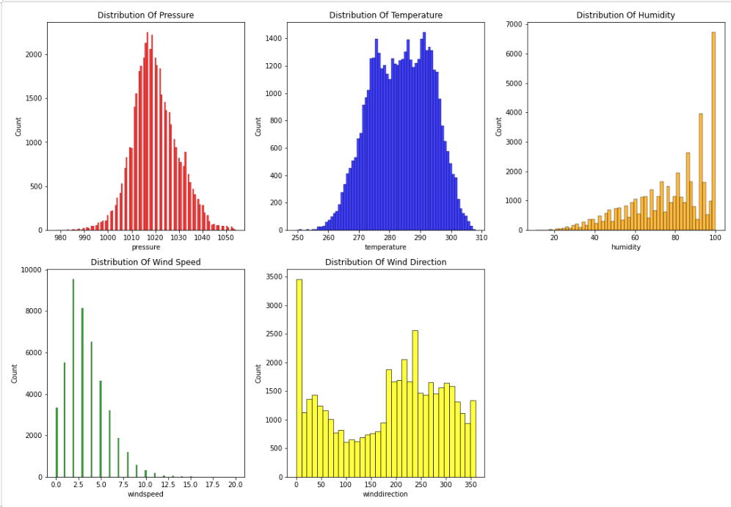
Visualizing the Feature variables

Slide 11
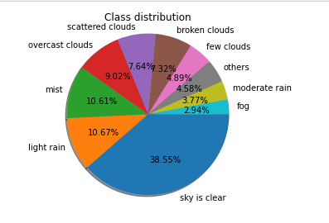
Visualizing the Target variables class

Slide 12
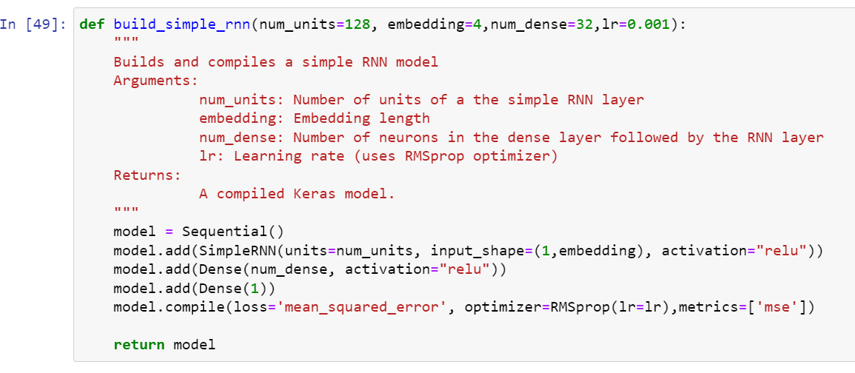
RNN Model Summary

Slide 13
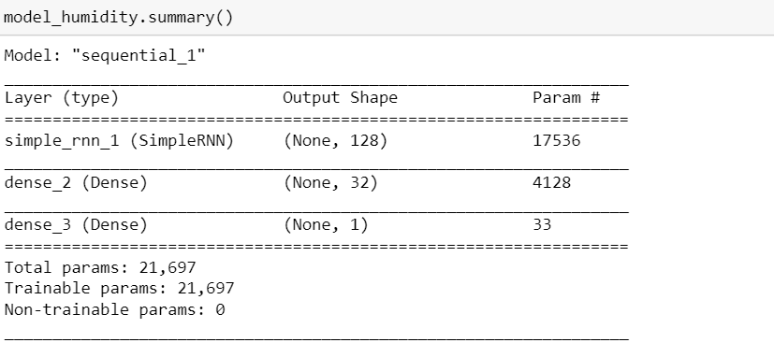
RNN Model Summary

Slide 14
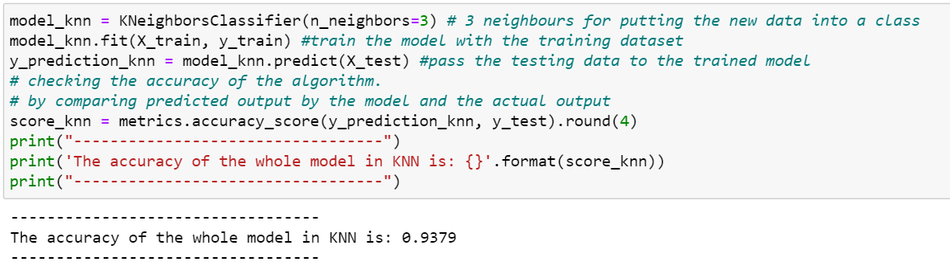
KNN Model Summary

Slide 15
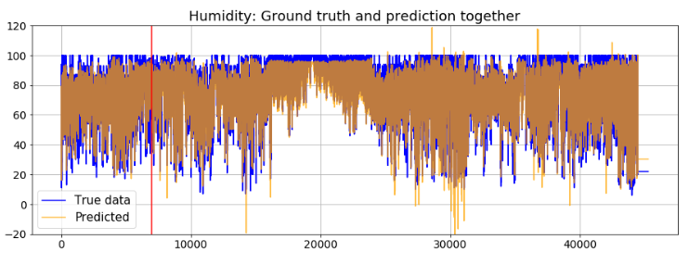
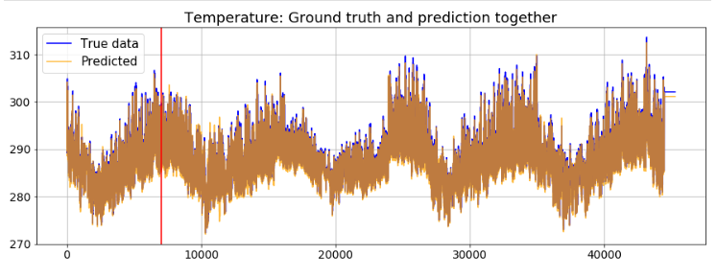
Result Analysis
Note carefully how the model is able to predict sudden increase in humidity around time-points 12000. There was no indication of such shape or pattern of the data in the training set, yet, it is able to predict the general shape pretty well from the first 7000 data points!

Slide 16
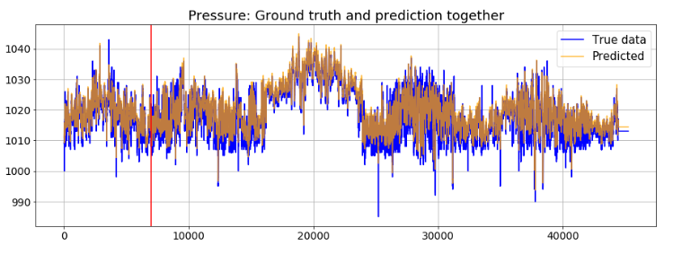
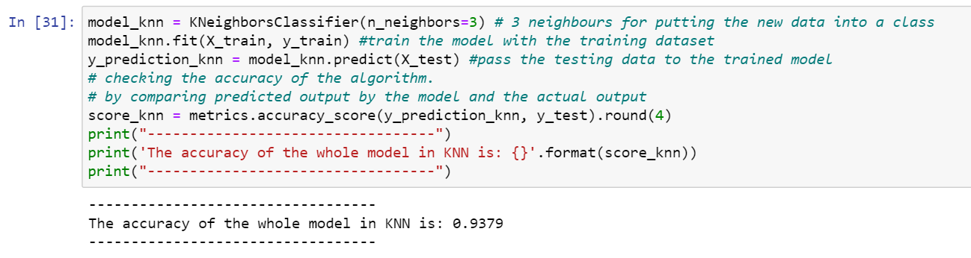
Again note how the model is able to predict sudden increase in pressure around time-points 18000-22000. There was no indication of such shape or pattern of the data in the training set (the boundary is denoted by the vertical red line), yet, it is able to predict the general shape pretty well from the first 7000 data points.
The accuracy of the whole model using KNN is 93.7% .

Slide 17
Discussion
Seaborn is a library for making statistical graphics in Python. It builds on top of matplotlib and integrates closely with pandas data structures.Smoothing technique helps to tackle the problem of zero probability in the Naive Bayes machine learning algorithm.Quick utility that wraps input validation and next(ShuffleSplit().split(X, y)) and application to input data into a single call for splitting (and optionally subsampling) data in a one liner.The K in the name of this classifier represents the k nearest neighbors, where k is an integer value specified by the user, this classifier implements learning based on the k nearest neighbors.In this project where we consider k value 3.An embedding is a relatively low-dimensional space into which you can translate high-dimensional vectors. Embeddings make it easier to do machine learning on large inputs like sparse vectors representing words.

Slide 18
Discussion
We build a simple function to define the RNN model. It uses a single neuron for the output layer because we are predicting a real-valued number here. As activation function, it uses the ReLU. Following arguments are supported.
neurons in the RNN layer
embedding length
neurons in the densely connected layer
learning rate
we have covered modeling the humidity data step-by-step in detail, we will show the modeling with other two parameters - temperature and pressure - quickly with similar code but not with detailed text.
There are, of course, some obvious mistakes in the model predictions, such as humidity values going above 100 and some very low values. These can be pruned with post-processing or a better model can be built with proper hyperparameter tuning.

Slide 19
Conclusion
The results show that proposed models produces very good results as compare to other algorithm prediction techniques. Although, we presented the results only for a city, but the model is capable to predict all cities.
Both algorithms accuracy up to 90%.
Here we able to use pressure,temperature ,humidity,weather description and full condition of wind data set because of getting higher accuracy
Fit to predict any regional ,any country’s weather
The code was examined and put to the test. According to the test results, the entire system performed in accordance with the project's intended goal and objectives. The weather forecasting software the algorithm was able to forecast the weather for the next seven days to within one degree month with a high level of precision and efficiency.
It can also be extended to climate prediction in which it will predict the climate at seasonal to interannual time scale.

Slide 20
Thank you.

